Slide 1


BRACT’s Vishwakarma Institute of Information Technology Artificial intelligence and Data Science
ADUA31203: Cloud Computing &Analytics
A Project On
Cloud-Optimized Task Management App Using Docker on AWS
Roll No. | PRN | Name of student
373059 | 22210161 | Sejal M. Tongire
373062 | 22210530 | Shreyash S. Vachkal
373065 | 22211394 | Nishant N. Wankhede
373073 | 22320146 | Purushottam S. Habib

Slide 2

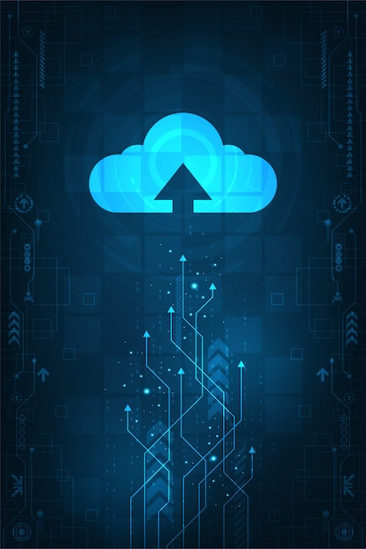
Cloud-Optimized Task Management App Using Docker on AWS
This presentation outlines the process of designing and deploying a containerized web application for task management using Docker and AWS EC2.

Slide 3

Introduction to Containerization and Docker
Containerization packages software with its dependencies into a self-contained unit.
Docker is a popular containerization platform that simplifies the creation, deployment, and management of containers.
1
Isolation
2
Portability
Containers isolate applications from the host operating system and other containers.
Containers can run consistently across different environments, such as development, testing, and production.
3
Scalability
Containers can be easily scaled up or down to meet changing demands.

Slide 4
Benefits of Containerization for Web Applications
Containerization offers numerous advantages for web applications, improving efficiency, scalability, and consistency.
Improved Deployment
Enhanced Scalability
Reduced Resource Usage
Containers simplify the deployment process by packaging applications with their dependencies.
Containers enable easy scaling of web applications by adding or removing containers as needed.
Containers share the host operating system's resources, reducing resource consumption compared to virtual machines.
This ensures that applications run consistently across different environments.
This allows applications to handle fluctuating traffic loads efficiently.
This leads to more efficient use of hardware resources.

Slide 5
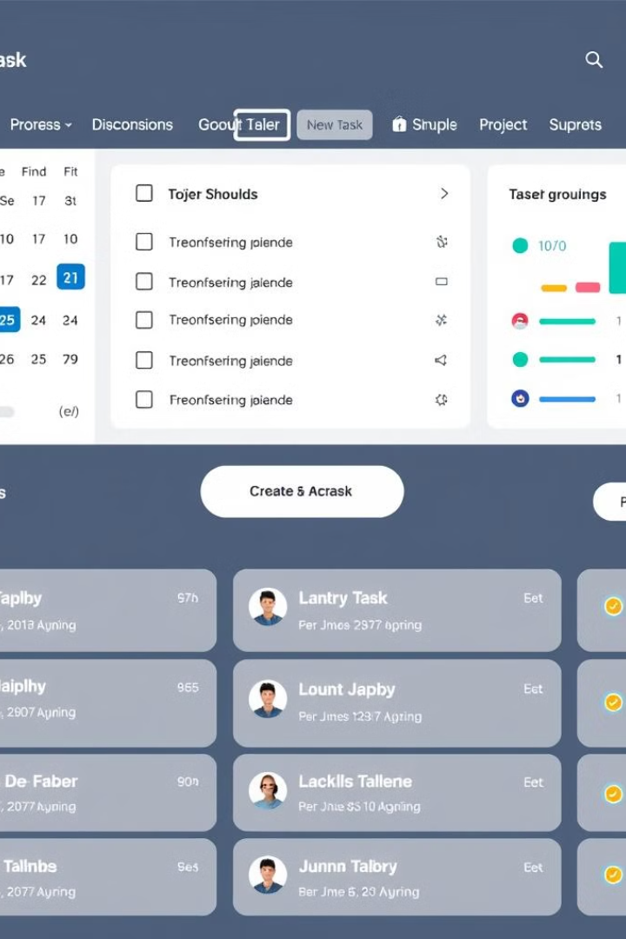



Architectural Overview of the Task Management Application
The task management application consists of a frontend user interface, a backend API, and a database.
Frontend
The frontend provides a user interface for interacting with the application.
Backend API
The backend API handles requests from the frontend and interacts with the database.
Database
The database stores task data, including details, assignments, and progress.

Slide 6
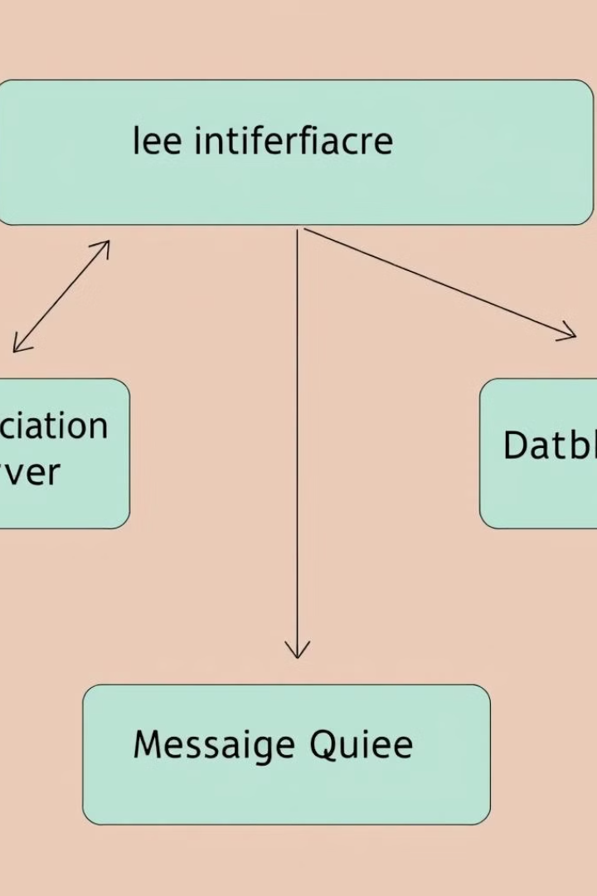
Designing the Application for Containerization
The application is designed with modularity in mind, separating components into distinct containers.
Each container has specific responsibilities, such as running the frontend, backend, or database.
Frontend Container
Backend Container
The frontend container runs the user interface, responsible for rendering the application's visual elements and handling user interactions.
The backend container hosts the API, responsible for processing requests from the frontend, interacting with the database, and managing application logic.
Database Container
The database container houses the database management system, responsible for storing and retrieving task data, managing user accounts, and ensuring data integrity.

Slide 7
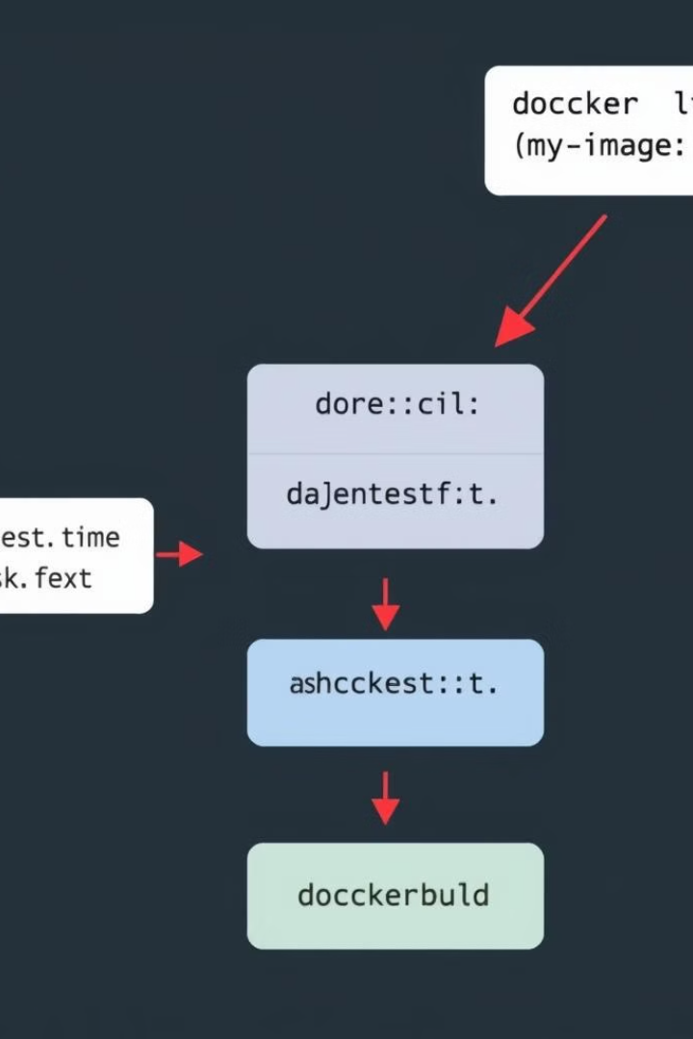
Building Docker Images for the Application Components
Docker images are built for each application component, containing all necessary dependencies and code.
These images ensure consistency and reproducibility across different environments.
1
Define Dockerfile
A Dockerfile defines the instructions for building the image, including the base image, dependencies, and application code.
2
Build the Image
The Docker build command executes the instructions in the Dockerfile to create the image.
3
Test the Image
The image is tested to ensure that it runs correctly and meets the application's requirements.

Slide 8
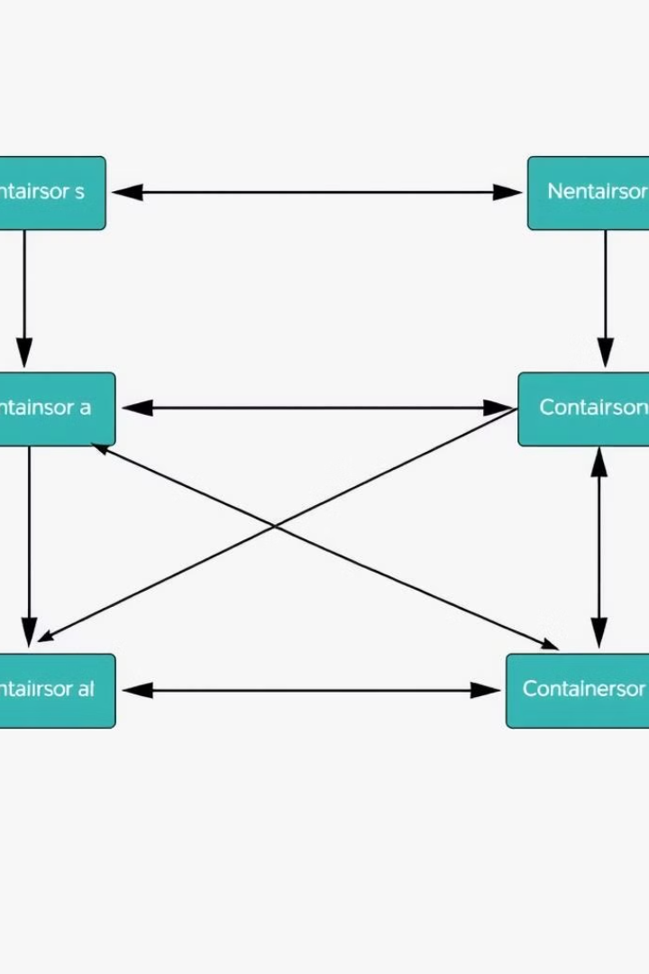
Configuring Docker Networking and Storage
Docker networking and storage are configured to enable communication between containers and persistent data storage.
These configurations ensure that containers can interact with each other and access data effectively.
Networking
Containers can communicate with each other using Docker's built-in networking capabilities.
Storage
Data can be persisted using Docker volumes, which provide persistent storage for containers.

Slide 9
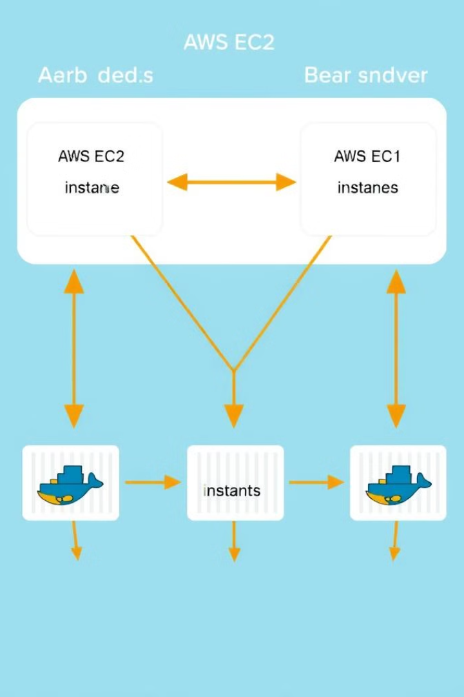



Deploying the Containerized Application on AWS EC2
The containerized application is deployed on AWS EC2 instances, providing a scalable and reliable platform.
AWS EC2 instances offer a wide range of options for configuring resources and managing the deployment environment.
Launch EC2 Instances
AWS EC2 instances are launched to host the containerized application.
Deploy Containers
The Docker images are deployed onto the EC2 instances as containers.
Configure Networking
Docker networking is configured to allow containers to communicate with each other and the outside world.

Slide 10
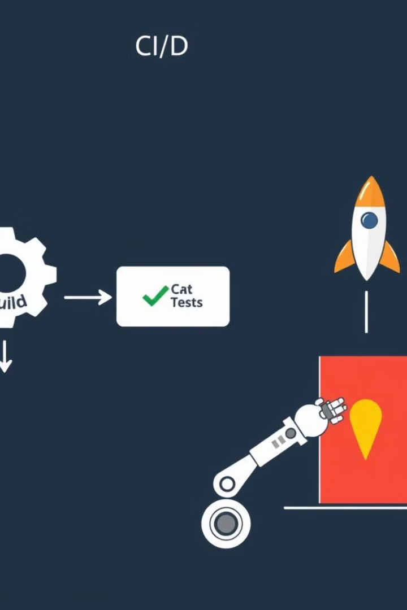
Automating the Deployment Process with CI/CD
CI/CD pipelines are implemented to automate the deployment process, streamlining development and deployment workflows.
CI/CD tools integrate with Docker and AWS EC2 to automate builds, tests, and deployments.
1
Code Changes
Code changes are pushed to a version control system.
2
Build and Test
The CI/CD pipeline builds Docker images and runs automated tests.
3
Deploy to AWS EC2
The CI/CD pipeline deploys the updated Docker images to AWS EC2 instances.

Slide 11
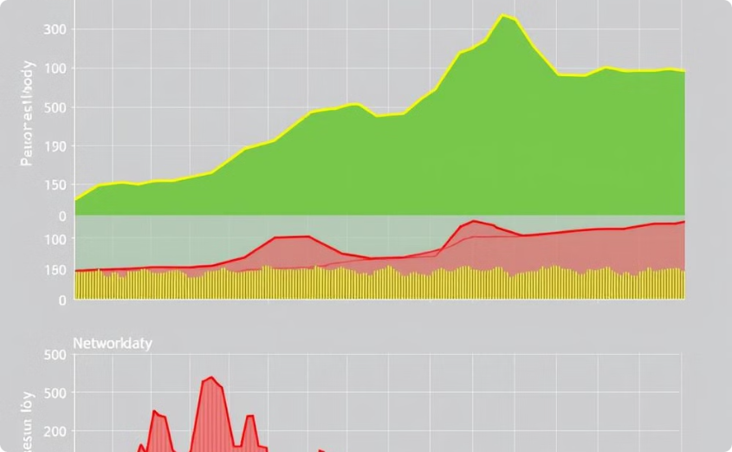

Monitoring and Scaling the Containerized Application
Monitoring and scaling capabilities are essential for ensuring the application's performance and availability.
AWS tools and Docker monitoring solutions are used to track the application's health and performance.
Performance Monitoring
Container Monitoring
AWS CloudWatch or other monitoring tools track application performance.
Docker's built-in monitoring capabilities provide insights into container health and resource usage.

Slide 12
CONCLUSION
The Cloud-Optimized Task Management App Using Docker on AWS demonstrates the power of cloud computing and containerization in creating scalable, efficient, and reliable web applications. By leveraging AWS EC2 instances for hosting and Docker for containerization, the project showcases how modern technologies can simplify application deployment, management, and scaling, ensuring seamless user experiences.
The use of AWS EC2 provides a highly flexible and cost-effective infrastructure for hosting the application, enabling on-demand resource allocation and high availability.
Docker further enhances this setup by ensuring portability and consistency across various environments, reducing dependency-related issues, and accelerating development cycles. This combination of cloud services and containerization allows the application to handle varying workloads effectively, making it well-suited for real-world scenarios.
Additionally, this project highlights the advantages of containerized applications in cloud ecosystems:
Scalability: The app can scale horizontally to meet increasing user demands without compromising performance.
Portability: Docker containers ensure that the application can run on any platform, making it adaptable to multi-cloud or hybrid environments.
Ease of Maintenance: With Docker, updates and patches can be applied seamlessly, minimizing downtime and enhancing reliability.
This project serves as a foundation for integrating advanced cloud-native solutions into modern web applications. By applying principles like microservices architecture, monitoring, and automation, future iterations of the application can further enhance functionality and user satisfaction.

